Slide 1
PROJECT -2
NextHikes IT Solutions Project 2: Data Harmonization and Insights Extraction - E-281024-M1PM-B8
Name – SANTOSH
Mobile no – 8377011874
Batch - Digicrome Academy | Data Science and AI | N-140724-E8-SS-27
T

Slide 2
What we have to work Data Acquisition Data wrangling Key challenges and how they were addressed Insights and findings from the dataset

Slide 3
STEPS TO WORK

Slide 4
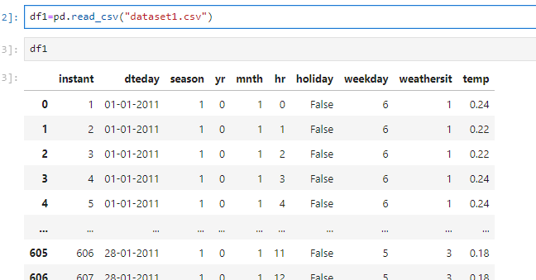
Import Required Data

Slide 5
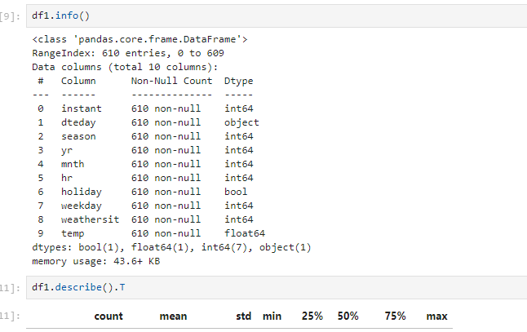
Data wrangling and cleaning steps

Slide 6
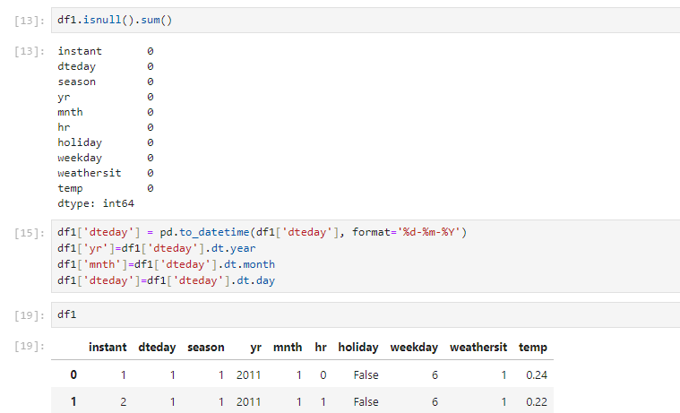
Data wrangling and cleaning steps

Slide 7
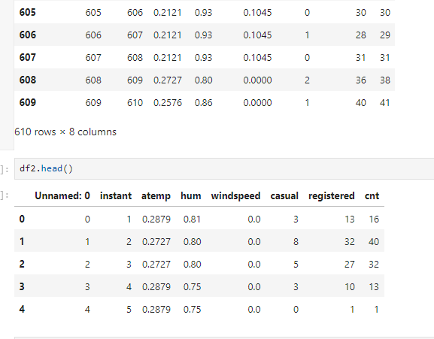
Data wrangling and cleaning steps

Slide 8
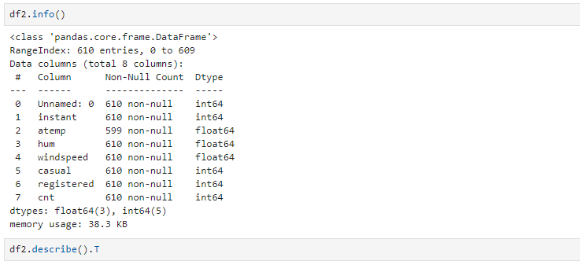
Data wrangling and cleaning steps

Slide 9
Key challenges and how they were addressed
combined = pd.merge(df1, df2, on='instant')
To add extra columns, we performed a left join on the first two datasets.
The left join was implemented using the default behavior of the merge function in pandas
df=pd.concat([combined,df3],ignore_index=True)
To append the new data to the previously joined data, we used the concat function in pandas.
df.isnull().sum()
Finding the total number of nulls in all the columns of the data frame
df["atemp"]=df["atemp"].fillna(df["atemp"].mean())
As there was only one column with missing values, and it was of data type int, filling the missing values with
the mean helps preserve the column's overall distribution and central tendency, ensuring it remains
representative of the dataset.

Slide 10
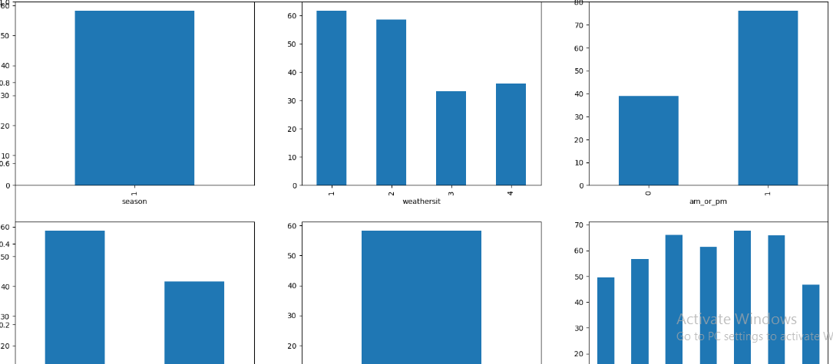
Insights and findings from the dataset

Slide 11
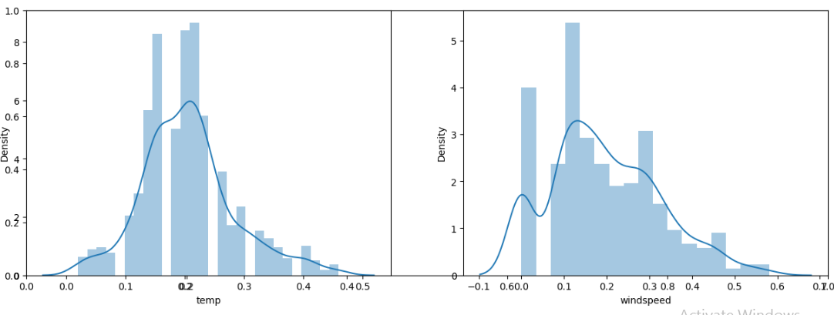
Insights and findings from the dataset

Slide 12
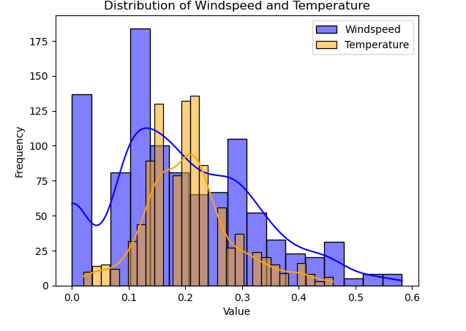
Insights and findings from the dataset

Slide 13
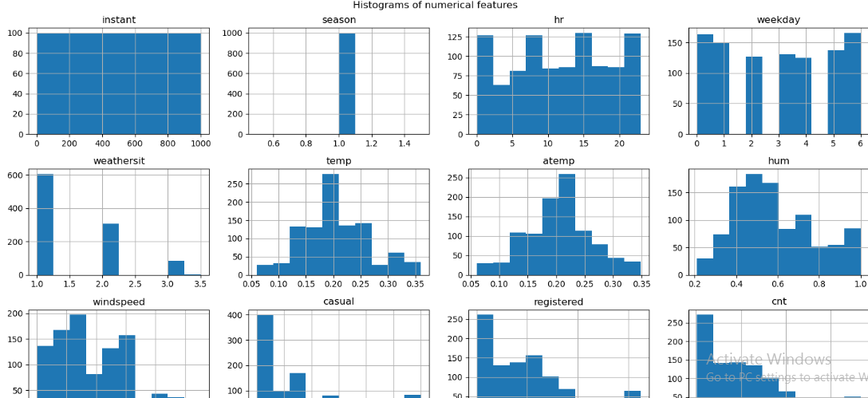
Insights and findings from the dataset

Slide 14
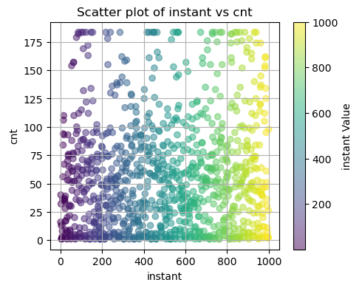
Insights and findings from the dataset

Slide 15
Summary
We are focuses on cleaning and wrangling multiple datasets by resolving issues such as missing values, duplicate entries etc.
Here we are using advanced data-wrangling techniques, the goal is to standardize and integrate data, ensuring accuracy and consistency.
Conclusion is clean dataset will serve as a reliable foundation for business analysis and predictive modeling.
Finally we have got the thing what we demanded.

Slide 16
THANKYOU

